Slide 2
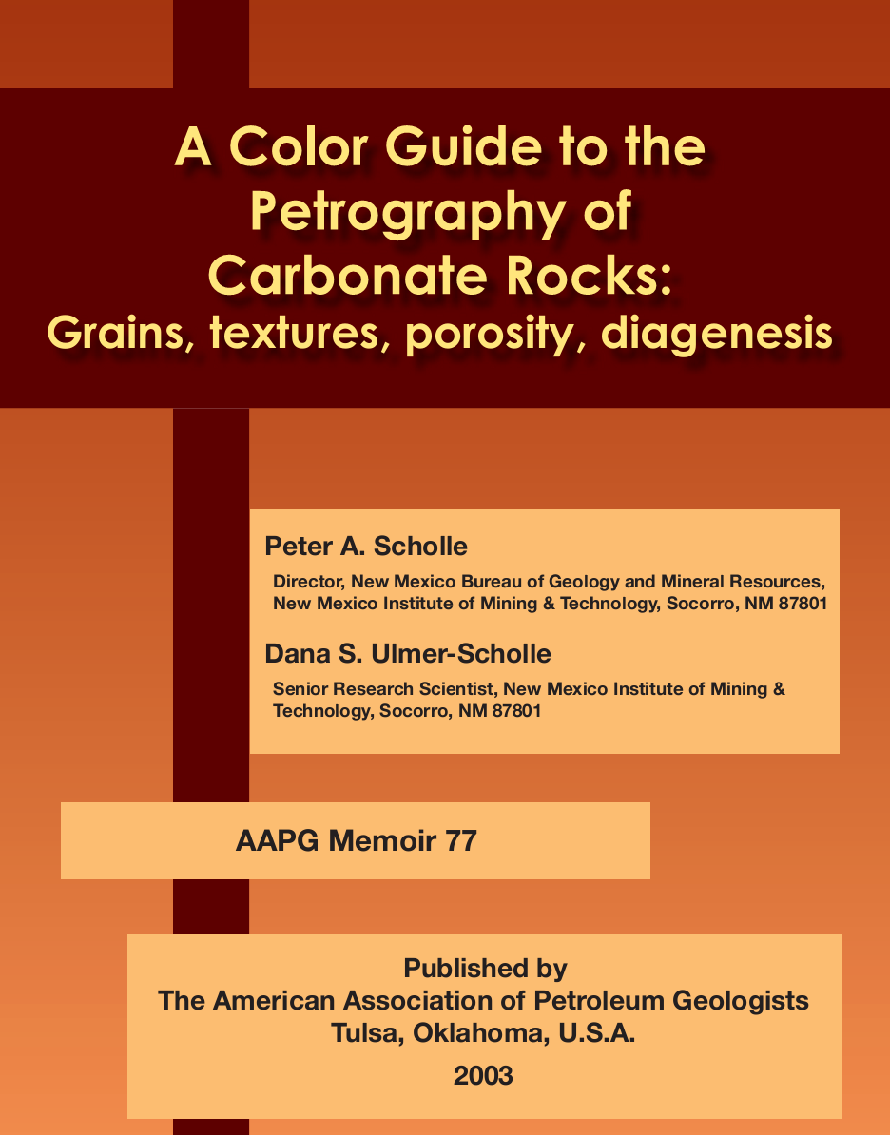

Slide 3
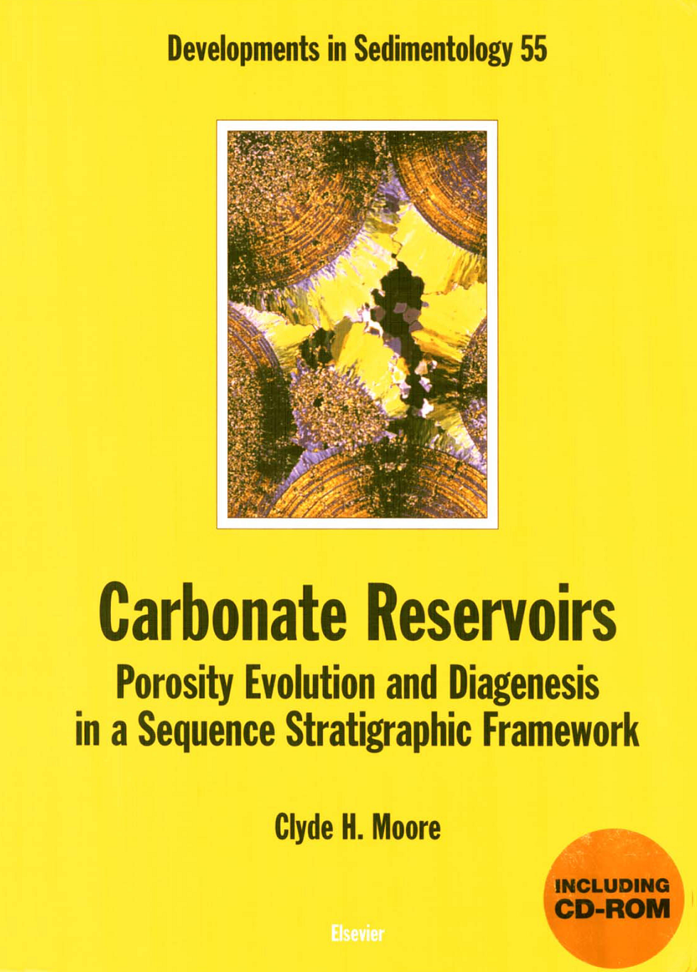

Slide 4
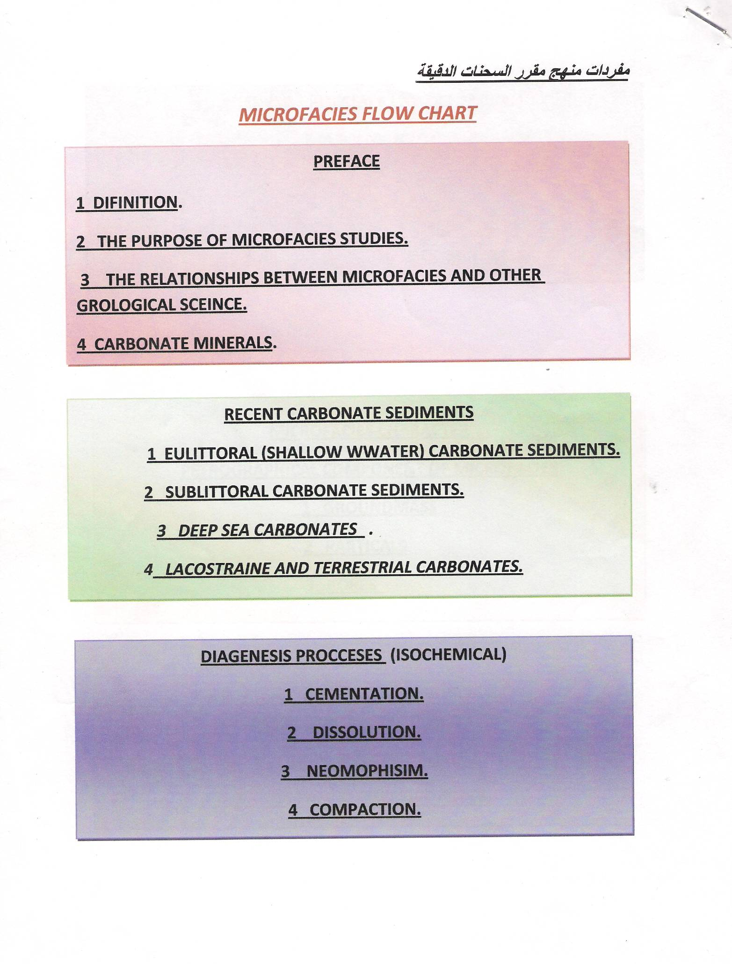

Slide 7
Carbonates are Born not Made

Slide 10
Sedimentology
Sedimentary rocks
paleoenvironment
Petroleum geology
Paleontology
Microfacies
Stratigraphy
Historical geology
Sequence stratigraphy
Reservoir geology
Petrology

Slide 11
Microfacies Project
Microfacies Project
Description
Analysis
Interpretation

Slide 12
Carbonate Minerals
Ca co3

Slide 13
There are three type of carbonate minirals
Calcite caco3
Aragonite caco3
Dolomite CaMg (co3)2

Slide 14
Carbonate Minerals
Aragonite
Calcite
Dolomite

Slide 15
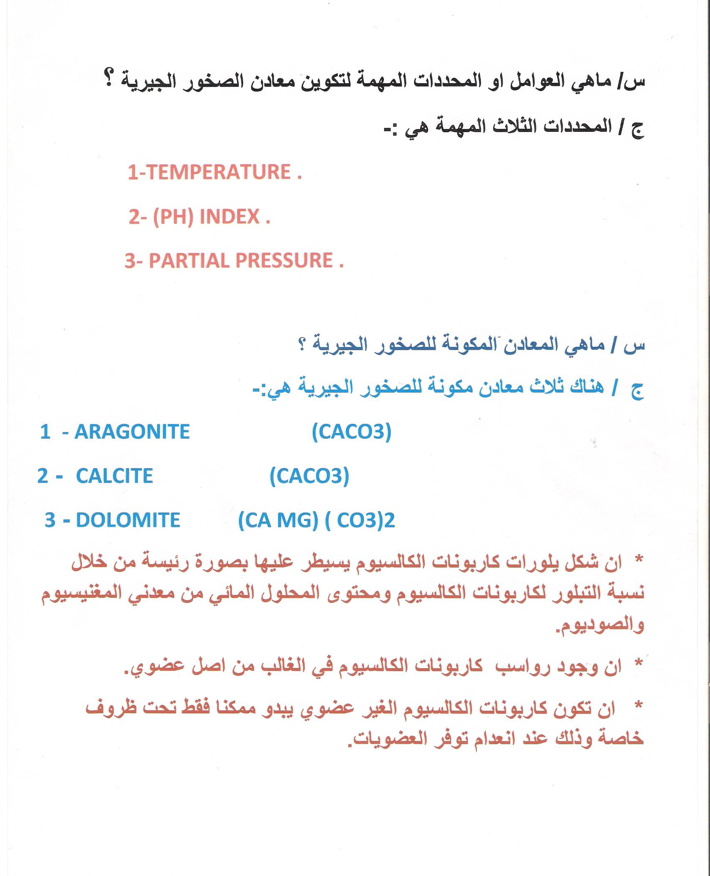

Slide 16
How can carbonate rocks precipitation
Biological
Chemical
Biochemical

